Slide 1
Loan Default Analysis: Are Unqualified Borrowers Being Targeted by Lenders?
Rohan Nitin Mahajan, Christy Sato, Chris Smith, Lennart Zeugner

Slide 2
Problem Description
Mortgage Crisis, 2008
Loans lended to unqualified borrowers
What are the key indicators of unqualified borrowers?
Prediction type
Classification

Slide 3
Dataset
Home Credit Default Risk
Kaggle
Approximately 300,000 rows
120 variables

Slide 4
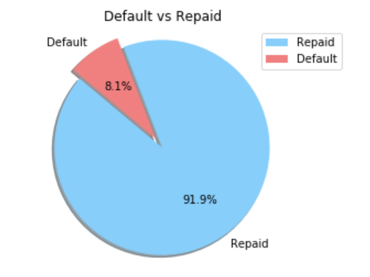
Descriptive Statistics - Target Variable
~ 92% of the loans in the dataset are repaid, while only ~8% default
The distribution of the target variable indicates an existing imbalance in our dataset
Notes:
The first variable we looked at is our target variable which indicates whether a loan was repaid or defaulted.
As we can see approximately 92 percent of the loans in the given data set were repaid, while only 8 percent defaulted.
That distribution demonstrates an existing imbalance in out target variable

Slide 5
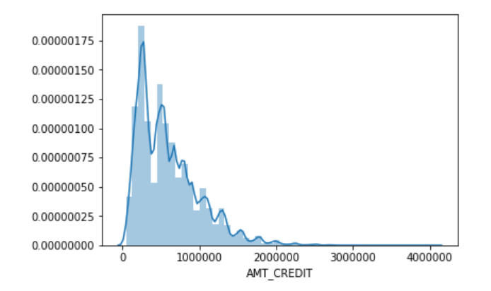
Descriptive Statistics - Total Credit Amount
Intuitively, it would make sense that total credit amount would be correlated with our target variable
The distribution of total credit amount is slightly right skewed with a mean of ~ $599000
Notes:
The second variable we looked at was total credit amount
Intuitively we thought that the total credit amount would have an effect on our target variable
The histogram shows that the distribution of the total credit amount is slighlty right skewed with a median

Slide 6
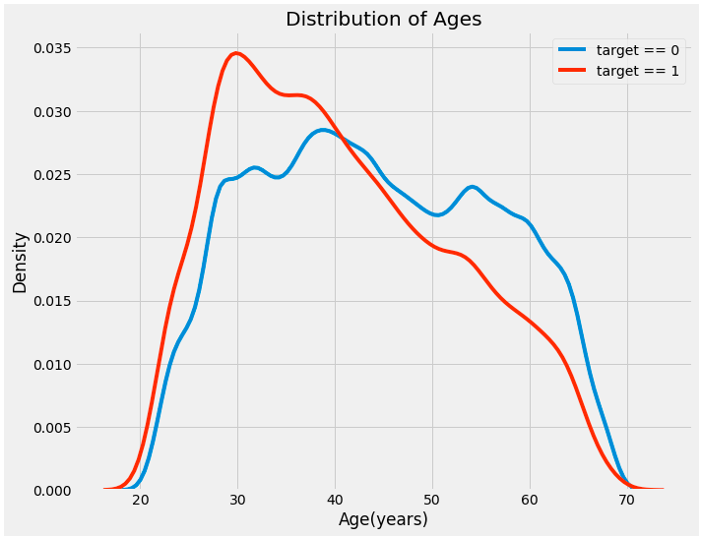
Descriptive Statistics - Age and Target
Those who defaulted, skewed toward younger ages
Between the ages of 29 - 40
Notes:
Days birth column are negative because recorded relative to current loan application
To see the days of birth column as years, we can divide the column by (-365)
Created a kernel density estimation plot (KDE) - shows distribution of single variable
Created by computing a kernel (usually Gaussian) at each point and then averaging individual kernels to develop single smooth curve

Slide 7
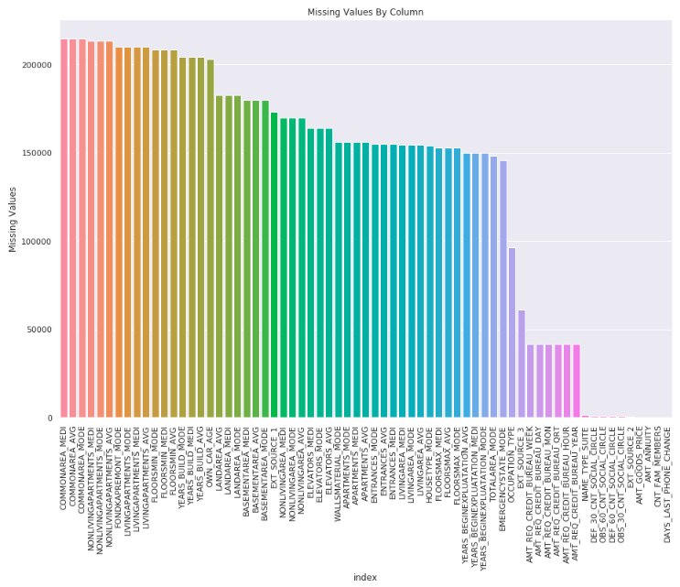
Descriptive Statistics - Missing Values
Information about where client lives (common area, number of floors, number of entrances, etc)
Number of inquiries to Credit Bureau
# of observations of client’s social circle

Slide 8
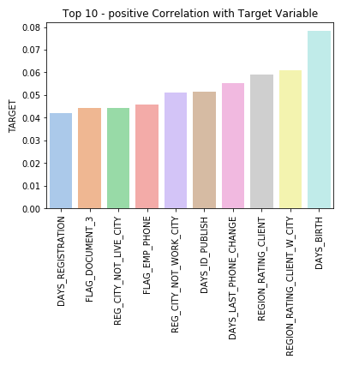
Exploratory Analysis - Positive Correlations
Top 3 Correlations:
Client Age
Lender rating of the region where client lives with taking city into account (1,2,3)
Lender rating of the region where client lives (1,2,3)

Slide 9
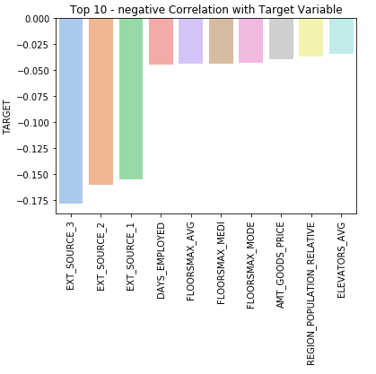
Exploratory Analysis - Negative Correlations
Top 5 Correlations:
Top 3 are normalized scores from external data sources. Metadata does not provide more information.
How long applicant has been employed at current job
Average number of floors of the building applicant lives in

Slide 10
Data Preprocessing & Feature Engineering
All categorical variables were converted to dummy variables
Created by udf called quick_dummies() to create several separate data frames
Used SK_ID_CURR as key for joins
Dropped columns with more than 60 percent of data missing
This will be something we work on moving forward
224 features -> 163 features after cleaning

Slide 11
Model Overview
Two different classification models
Logistic Regression
Using varying elastic net parameters and PCA k values
60% training, 30% validation, 10% testing
Infer what variables indicate a high probability of default
Moving towards more complex model in the future
Random Forest
Clustering - K-Means

Slide 12
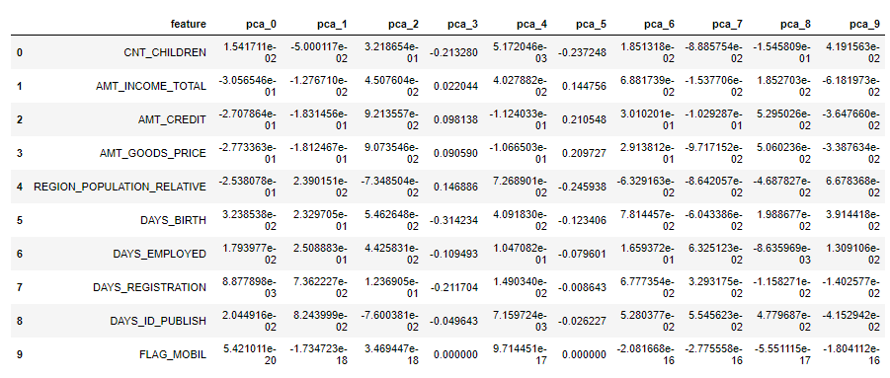
Models
AUC Score - It can be thought as how good is the model at ranking the probabilities of the real labels
Models | Parameters | AUC Score (Val)
Model 1 Logistic Regress | maxIter = 10 | .62
Model 2 Logistic Regress | maxIter = 20 StandardScaler PCA(k=10) elasticNet=.2 | .70
Notes:
If you randomly chose one positive and one negative observation, AUC represents the likelihood that your classifier will assign a higher predicted probability to the positive observation
Auc is useful when high class imbalance

Slide 13
Evaluation Metrics
Three of the most popular classification metrics are AUC, Recall, and Precision
Best Performing Model - Model 2:
ROC Area Under Curve (Test)
.72
Recall (Test)
0 = .91
1 = .41
Precision (Test)
0 = .91
1 = .03
Notes:
Which metrics to focus on depends on the business problem
Wanna focus on recall since we are interested in correctly predicting loan defaults

Slide 14
Problems Encountered & Solutions
Problems:
Imbalanced Dataset
Missing Values
Low recall score
Solutions:
Random sample size of default values to balance dataset
More advanced models to improve performance metrics
Notes:
Recall Score: Because false positive(normal loan is flagged as default) are more acceptable than false negatives (default loan is classified as normal)

